Slide 1

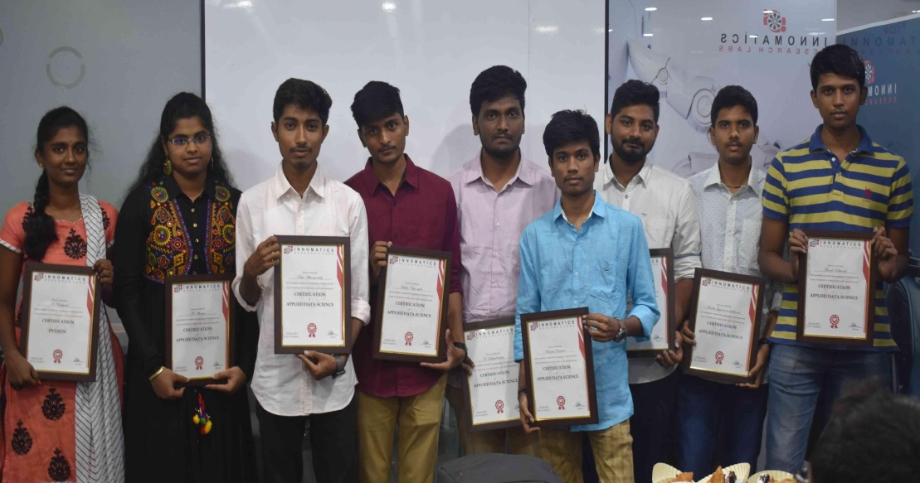
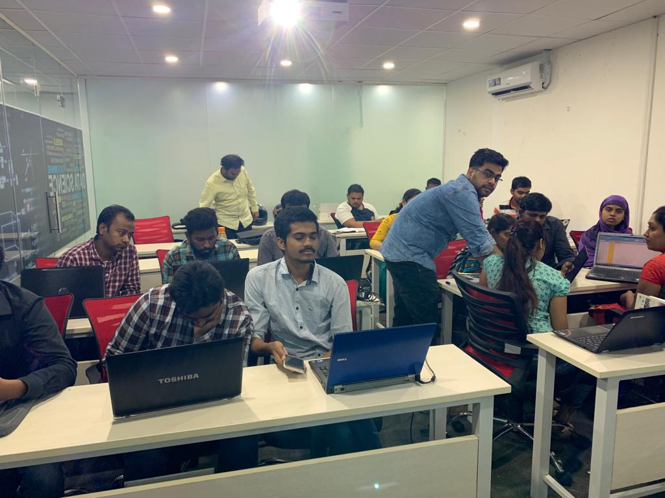

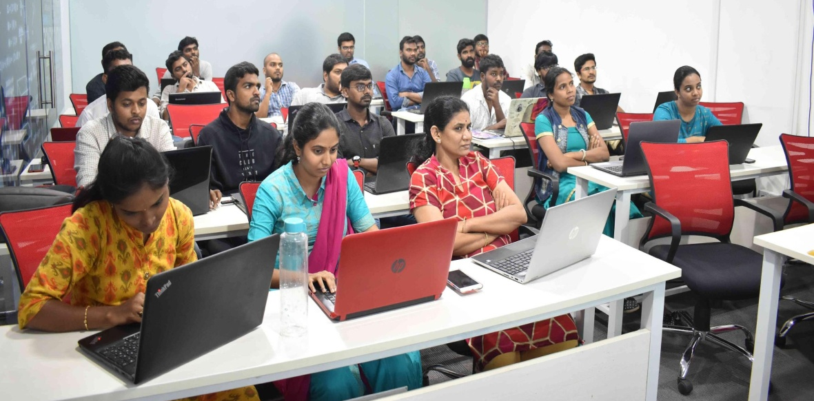
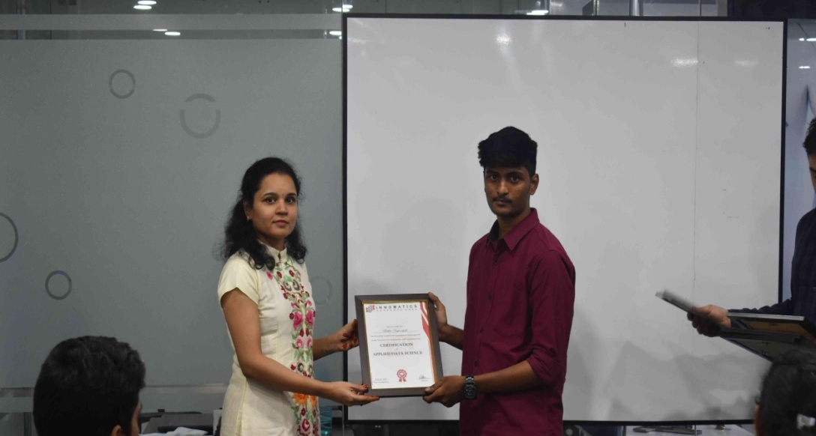
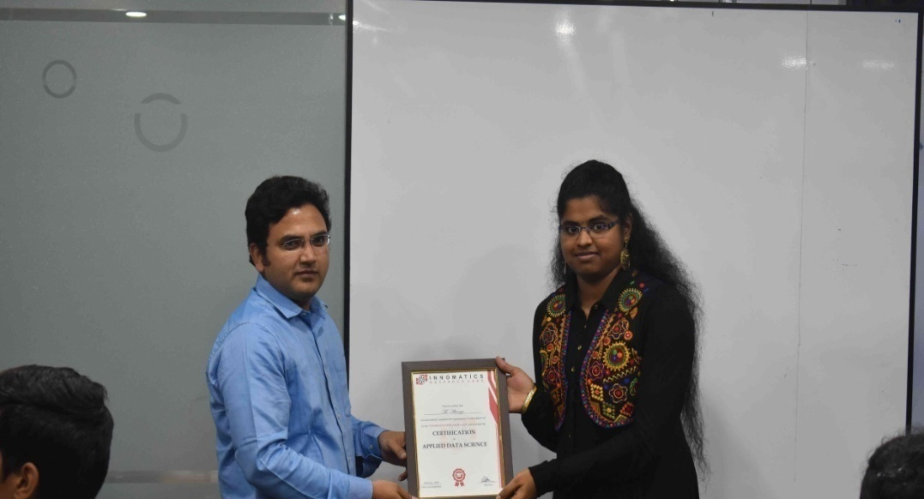

Slide 2
Webscraping and Data Analysis on - Cars24 Website
Name:- Jayaram Maipala

Slide 3
About me
My Educational Background :- B-TECH(Electronics and Communication Engineering).
I am very much interested in doing business after my studies.But I need some skills to sort out the things relate to data in any type of businesses,and also it will be very much useful to develop and promote any business.That’s where my interest in data science begins and then I keep on researching about the data science and everytime I learn something new in this.
Work Experience :- Iam working in infosys as system engineer from past 1 month in SAP stream.

Slide 4
Agenda:
Business Problem
Objective of the Project
Web Scraping – Details (Websites, Processor i followed)
Summary of the Data
Data Cleaning
Data Manipulation
Univariate Analysis
BiVariate Analysis
Key Business Question
Conclusion (Key finding overall)
Q&A Slide
Your Experience of the Web Scraping – Data Analysis Project.

Slide 5
Business Problem :
Cars 24 is an online website where people can buy and sell their cars very easily.
Here the main business problem is for employes who are working in cars24,that they should not understand the cars data by seeing it in unstructured manner.
If the employes are not understanding the things like how many types of cars are uploaded and in that which type of cars are sold out fastly and all these things then they don’t have any clarity to involve in business progress.
And customers are also facing problem with checking the specifications and all other things about the car individually.

Slide 6
Objective of the project :
To extract the large set of cars data from website and create a data frame by having several required data objects in it.
And then we convert the dataframe into several visualizations based on the input data.
So that we can understand the data very easily by seeing it on a pictorial representation.
“ A PICTURE SPEAKS A THOUSAND WORDS “

Slide 7
Web Scraping :
Web scraping is a method to obtain large amounts of data from websites. Most of this data is unstructured data in an HTML format which is then converted into structured data in a database so that it can be used in various applications.
Here we take cars24 as website to scrape the data.
Beautiful Soup is the python package which we are used in this web scraping process and it is very much useful in extracting HTML content from website.
Cars24 website Beautiful soup Extracting Html Extracted data
data stored in objects

Slide 8
Summary of the data :
The data scraped from the website is
1.Brand name
2.Car Model
3.Mfg Year
4.Kms Driven
5.Price
6.Emi Facility
7.Kms Driven
8.Owner Type
9.Gear Type

Slide 9
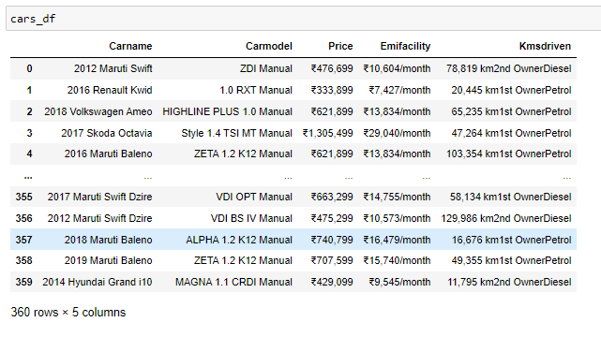
Data Cleaning :
I use Pandas tool to clean the data and to create a dataframe .
Pandas tool is used in cleaning the data in large datasets.
In this project I use pandas to create a dataframe for the data extracted from the website.
And also by using this pandas I can add some extra data columns which is extracted from the other data columns.Below dataframe is created by using pandas for this project.

Slide 10
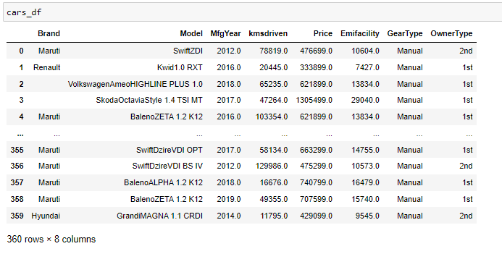
Data Manipulation:
For data manipulation i use regular expressions to modify or change the data .
And also regex is used to extract the data from one column and then add that data into another new data column.
Some of the unnecessary columns are dropped from the dataframe and some of the column names are changed and datatypes are also converted here.
After doing data cleaning and data manipulation the final dataset is shown below.

Slide 11
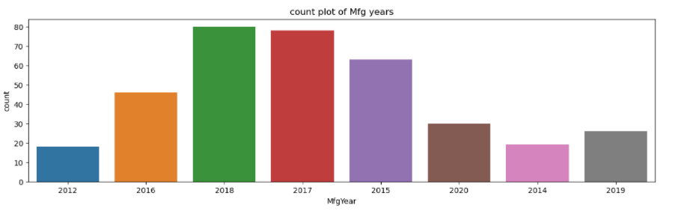
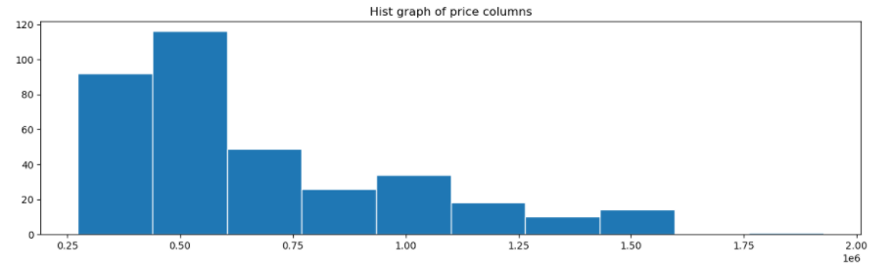
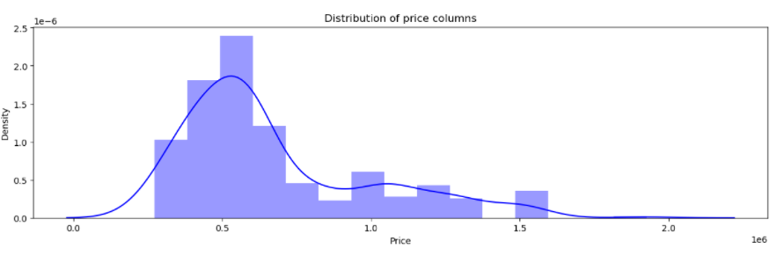
Univariate Analysis :
Analysis with only one variable is called univariate analysis.
Some of univariate analysis plots are shown below

Slide 12
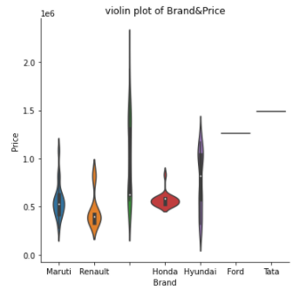
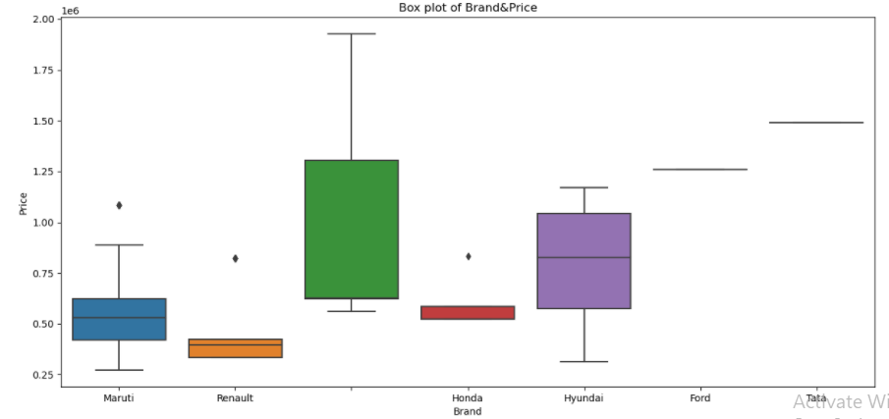
Bivariate analysis :
Analysis with two variables is called Bivariate analysis.
Few Bivariate analysis plots are shown below

Slide 13
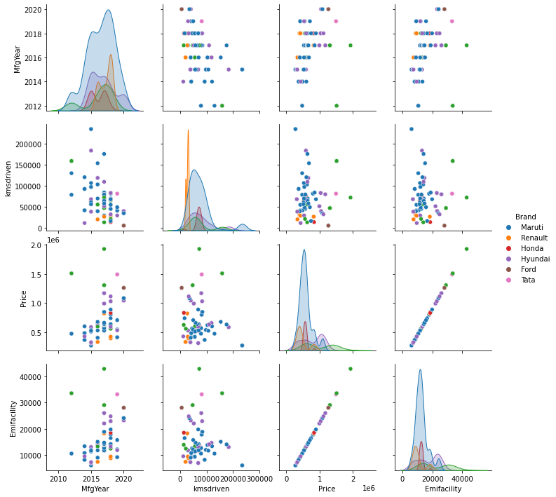
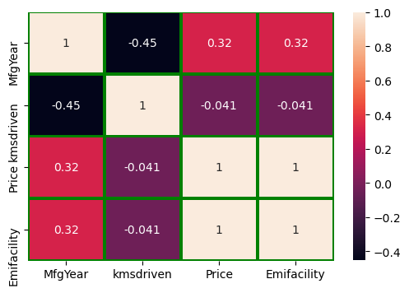
Multivariate analysis
Analysis with more than two variables is called Multi variate analysis.
Some of the multivariate plots are shown below

Slide 14
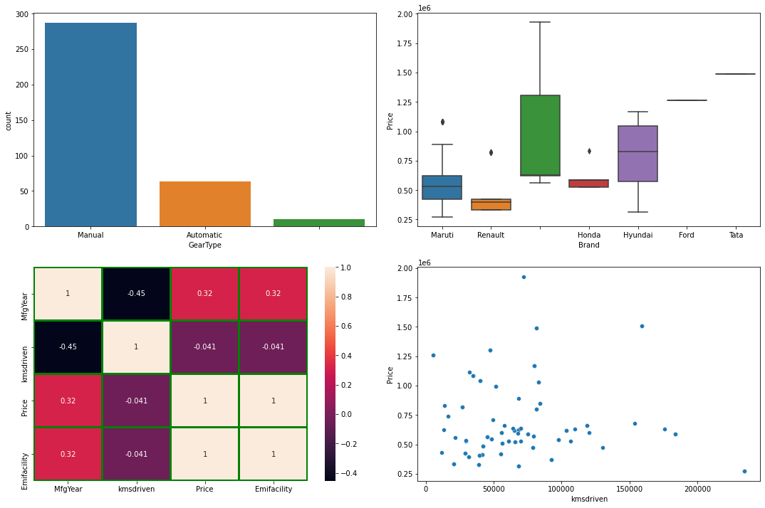
Key Business question :
How to pick a specific collection of data from a whole dataframe by visualizing in several plots to understand easily?

Slide 15
Conclusions :
People choose to sell Maruti brand cars mostly and Tata brand cars leastly.
Most number of cars are manual geartype cars and automatic cars are very less.
Highest price carbrand is Toyota and least price car brand is Maruti.
Mostly people will prefer diesel and manual type of cars for good mileage and low maintainenance cost.
And every car is eligible for zero downpayment option and so many flexible emi’s ranging from minimum of 6079 to maximum of 42854 based on car prices.
The most number of cars coming for sale are less than 20000 kms driven cars.
These are the few points which I considered from the cars24 dataset.

Slide 16


Slide 17
My Experience in this project :
I had great experience in this project and I have learnt so many things while doing exploratory data analysis.
For me the scraping of data from website and visualization parts are very much interesting and I thoroughly enjoyed doing that parts.
I also faced so many challenges in the process but my mentors are very much supportive and explained all the things so that I can complete all these things very easily.
This is my first project in my professional career and It gave me so much confidence to go further .
I sincerely thankful to my project mentor MR.Himanshu Goswami for his support .

Slide 18

THANK YOU

